Slide 1
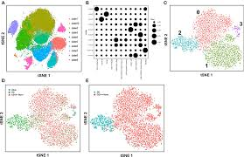
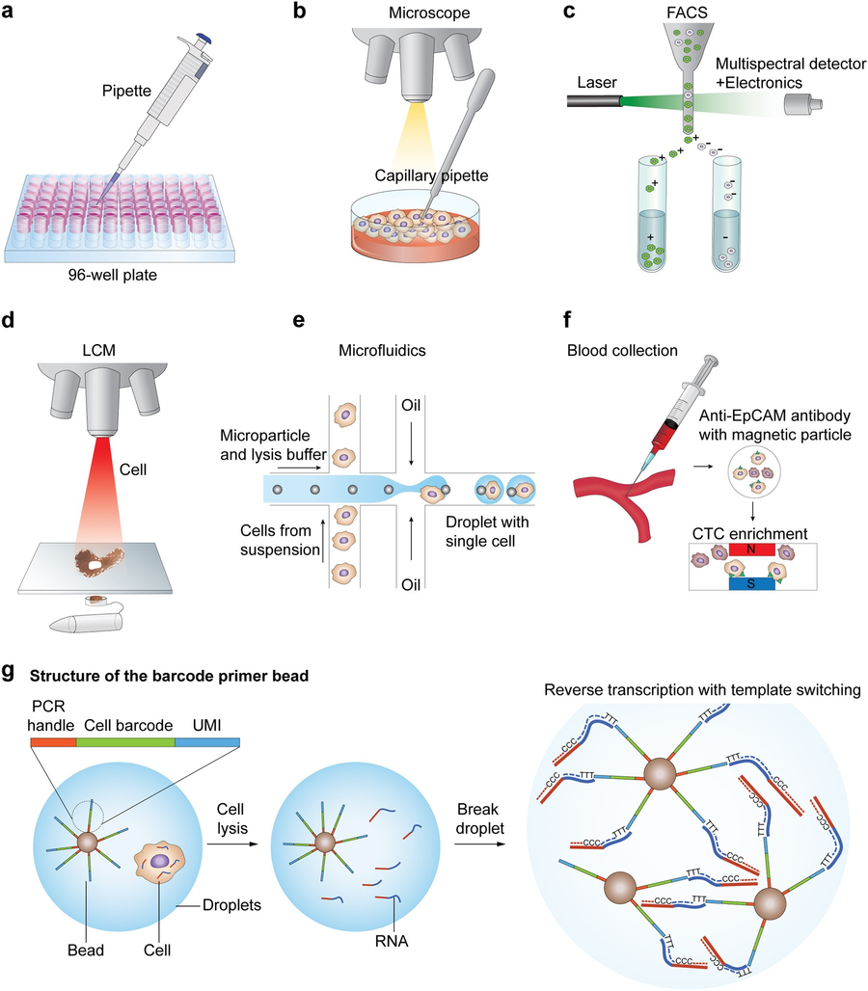
Single-cell sequencing deconvolutes cellular responses to exercise in human skeletal muscle.
Literature Review By:
Safwan Ismaun Amin, 2311443642
1

Slide 2
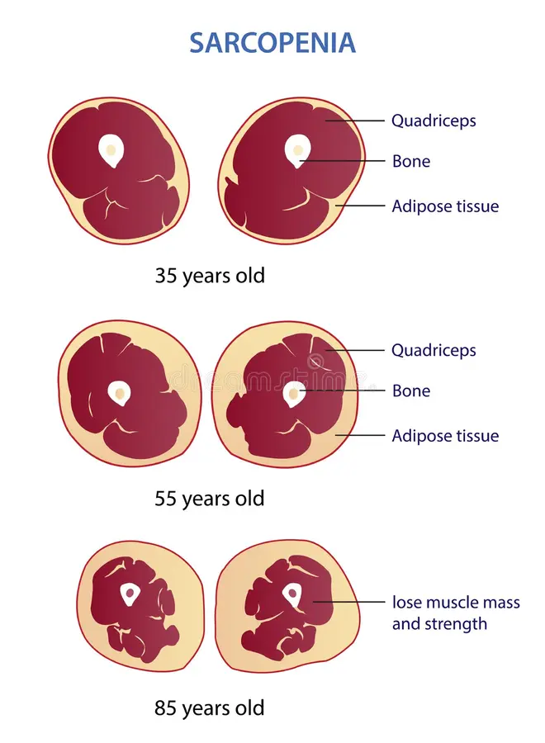
Abstract
We know what adaptations skeletal muscles have in response to exercise, but we don't know cell-specific adaptations.
Single-cell sequencing is used on a sample of muscle cells before and after intense exercise.
15 clusters from 6 cell populations
Most cells are stable, but a large response is seen in mesenchymal, endothelial and myogenic cells(that means these are the cells which repair muscle tissues).
3 subpopulations of myogenic cells expressed by PAX7,MYOD1,TNNI1, and TNNI2
Exercise matures the myogenic progenitor cells by increasing transcriptional features of fast and slow twitch muscle fibers present in the primary myoblast cells.
These effects may have implications for sarcopenia, cachexia, and glucose homeostasis.
2

Slide 3
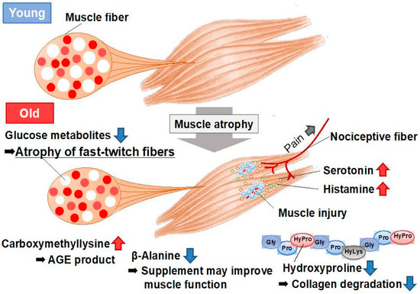
Introduction
Functions of Skeletal Muscle
Skeletal muscle plays a vital role far beyond movement. It enables locomotion by generating force for posture and motion, but it is also a major metabolic organ involved in glucose and fat regulation. Through these functions, skeletal muscle significantly influences physical performance, overall health, and the progression of chronic diseases across all age groups.
Key Features of Skeletal Muscle
Skeletal muscle fibers are long, multinucleated cells specialized for contraction. These tissues are highly plastic, meaning they can adapt structurally and metabolically in response to stimuli such as exercise, injury, or aging. Because of their adaptability, skeletal muscles undergo remodeling to meet changing physical and metabolic demands.
Cellular Effects of Exercise
Exercise triggers a coordinated response from multiple cell types within the muscle. Immune cells contribute to inflammation resolution and tissue recovery. Fibroblasts secrete cytokines that aid in structural remodeling, while endothelial cells promote muscle regeneration by releasing growth and anti-apoptotic factors. Together, these cells support muscle repair and adaptation after exercise.
3

Slide 4
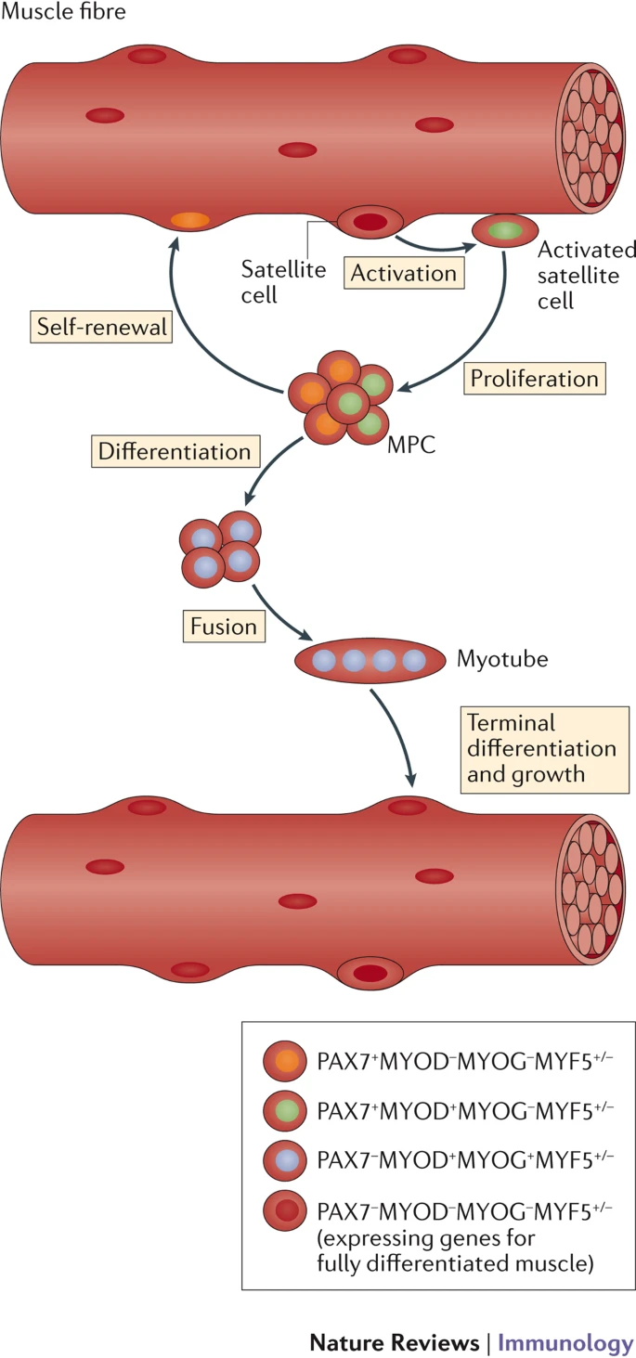
Insights from Single-Cell Sequencing
Single-cell RNA sequencing has revealed previously unrecognized cellular diversity in skeletal muscle. It identified large populations of mesenchymal cells, endothelial cells, immune cells, and satellite cells, including fibro-adipogenic progenitors (FAPs). These FAPs play a key role in metabolic adaptation but can contribute to fibrosis and fat infiltration if dysregulated. Such insights are critical for understanding muscle aging and disease.
Satellite Cells and Muscle Regeneration
Satellite cells are the primary myogenic stem cells responsible for muscle repair and regeneration. However, their numbers and function decline with age and in diseases such as heart failure and diabetes. This reduction limits the muscle’s ability to recover, highlighting the importance of studying these cells for therapeutic purposes.
Study Objective and Cell Distribution
The study aims to focus on myogenic subpopulations and their role in skeletal muscle adaptation. Single-cell data indicate that muscle tissue is composed of several major cell types, including approximately 44% endothelial cells, 26% mesenchymal cells, 18% myogenic cells, and various immune cells. Understanding these proportions provides context for interpreting cellular responses to exercise.
4

Slide 5
Research Methodology
1. Study Participants
Three healthy adults (1 female, 2 males), aged 18–50, physically active. Participants gave informed consent under ethical approval.
2. Exercise Intervention & Muscle Biopsy
Participants completed 3 × 30-second all-out cycling sprints. Muscle biopsies were taken from the vastus lateralis before and 3 hours after exercise.
3. Cell Isolation & Preparation
Biopsied tissue was enzymatically digested, filtered to remove debris and red blood cells, and prepared for single-cell RNA sequencing.
4. Single-Cell RNA Sequencing (scRNA-seq)
Cells were processed using 10x Genomics Chromium and sequenced via Illumina HiSeq2500.
5. Data Pre-processing
Processed with Cell Ranger, Scanpy, and Seurat.
Low-quality cells were removed.
BBKNN (Batch Balanced K-Nearest Neighbors — used to correct batch effects and align cells from different samples) was applied to integrate datasets.
Clustering performed with Leiden clustering (a graph-based community detection algorithm used to identify distinct cell populations).
Visualized with UMAP.
6. Doublet Detection
DoubletFinder was used to identify and remove doublets (artificial merged cells).
7. Differential Expression Analysis
Conducted using Wilcoxon signed-rank test (a non-parametric test comparing gene expression between paired conditions, such as pre- vs post-exercise).
Genes with fdr < 0.05 and expression in >50% of cells were considered significant.
8. Cell Type Annotation
Annotation was confirmed using scCATCH, CellMatch, and Human Gene Atlas.
Gene set enrichment via ClusterProfiler.
9. Myogenic Trajectory & Pseudotime Analysis
Pseudotime analysis (a method to order cells along a developmental trajectory based on transcriptional states) was performed using principal curves.
Tracked transitions from stem-like PAX7+ cells to mature myotubes.
10. Comparison to Bulk RNA-seq (GTEx)
Integrated with GTEx bulk RNA-seq to compare tissue-level exercise responses.
11. Cell Culture Validation
Human myoblasts and C2C12 mouse cells were used for validation through qPCR and microarray analysis.
12. Data & Code Availability
Data: GEO GSE214544
Code: GitHub (HypoChloremic/scMuscle)
5

Slide 6
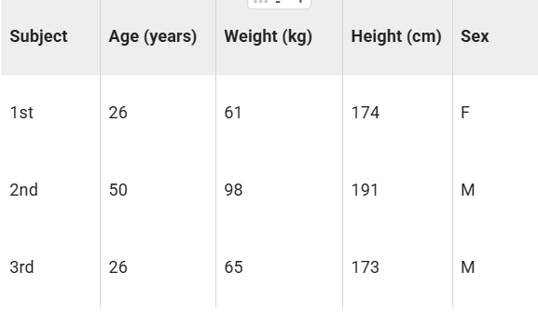
Test Sample
3 healthy, moderately active individuals before 3 30s sprints with 2min recovery.
Average Peak Power was 8.87 ± 2 W/Kg or 10.3 METs.
Total energy expenditure was 14.5 ± 6.9 KJ.
Tissue retrieval was 500 ± 150 mg per sample.
Pre-workout cell count=39,015 and Post-workout cell count=24,332. Mean read count of 19,507,451 and 19,328,882.
Cells sequenced from the third subject were sequenced twice for reproducibility.
The eight samples ( 6 from the three and the 2 re-sequenced) were integrated, anchored and clustered
6

Slide 7
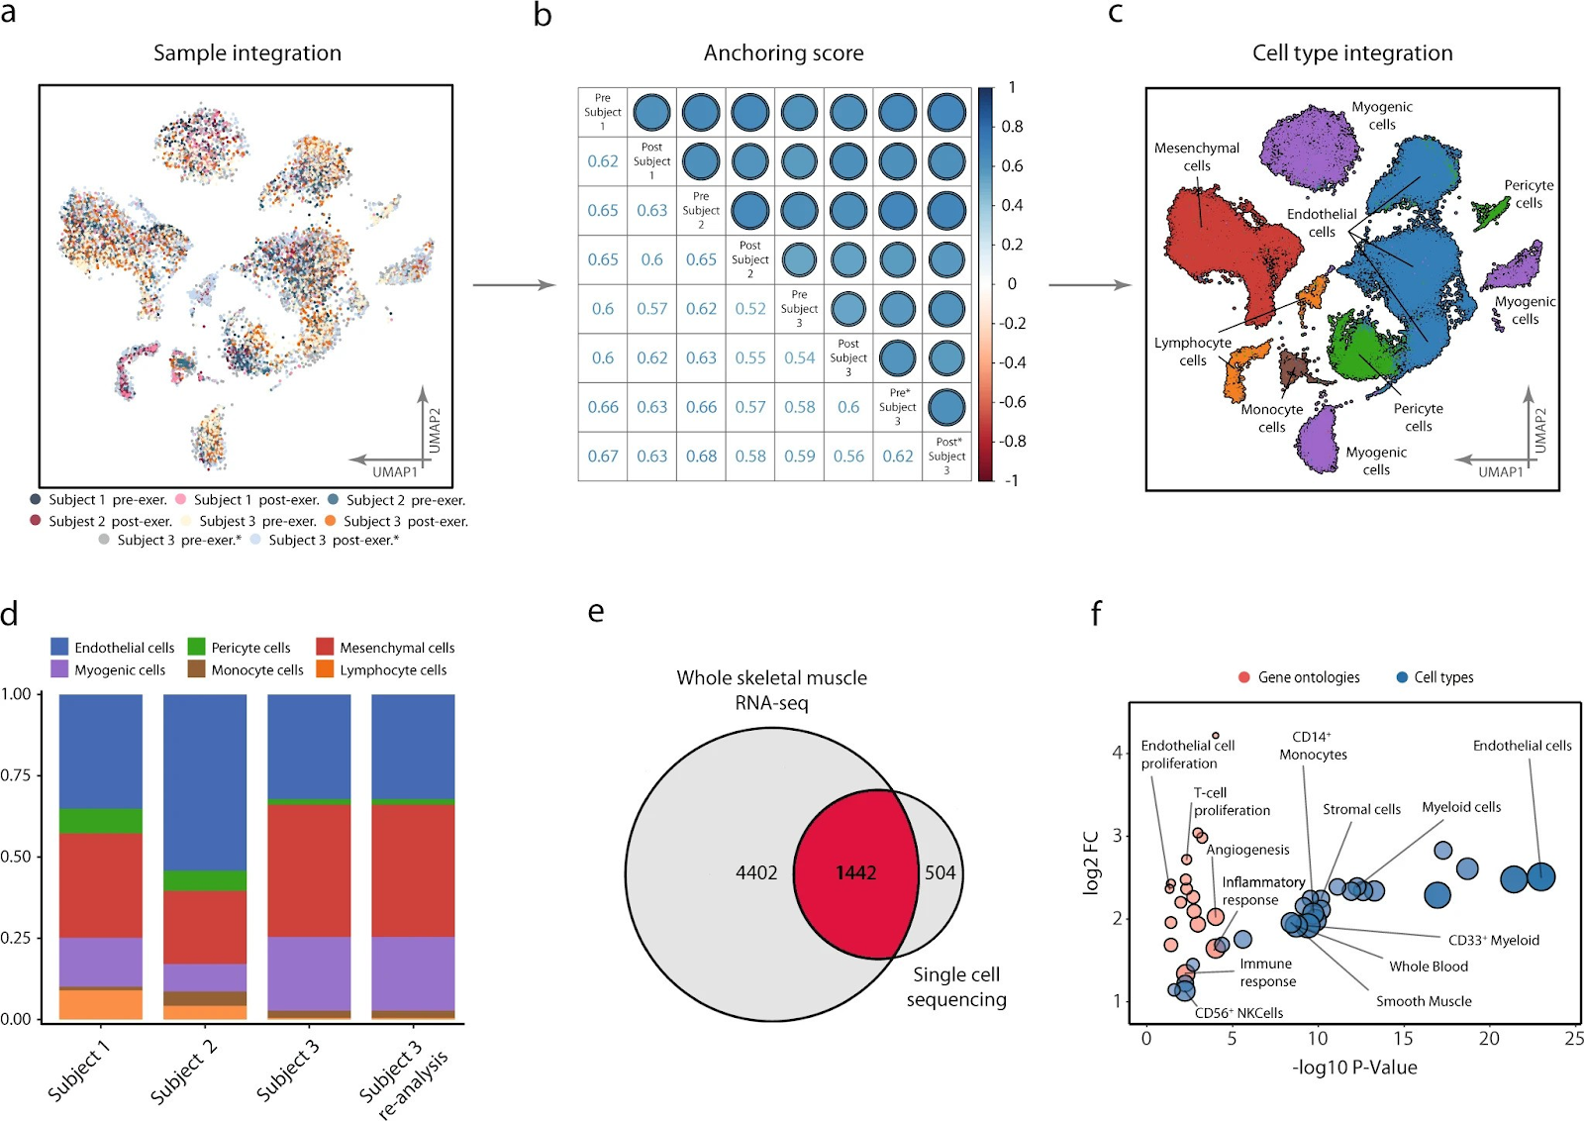
Cell-type annotation and reproducibility (Fig 1)
Figure 1:
Researchers analyzed 63,000 cells from muscle biopsies (vastus lateralis) taken from three people. These cells were grouped and visualized using UMAP, and the distribution showed six main cell types. Cells from all donors appeared evenly across these groups, proving the method is reliable and reproducible.
A correlation matrix (anchoring scores) confirmed that results were consistent both between different people and within the same person (including a resequenced sample).
The six identified cell types included mainly
Endothelial cells (44%)
Mesenchymal cells (26%)
Myogenic cells (18%)
Total RNA sequencing detected 5844 transcripts in muscle tissue, while scRNA-seq found 1946 unique transcripts. Notably, 504 transcripts (26%) were only detected by scRNA-seq, many of which belonged to rare cell types like endothelial, immune, and stem cells. This shows that scRNA-seq can reveal cell-specific gene activity that traditional bulk RNA sequencing might miss.
7

Slide 8
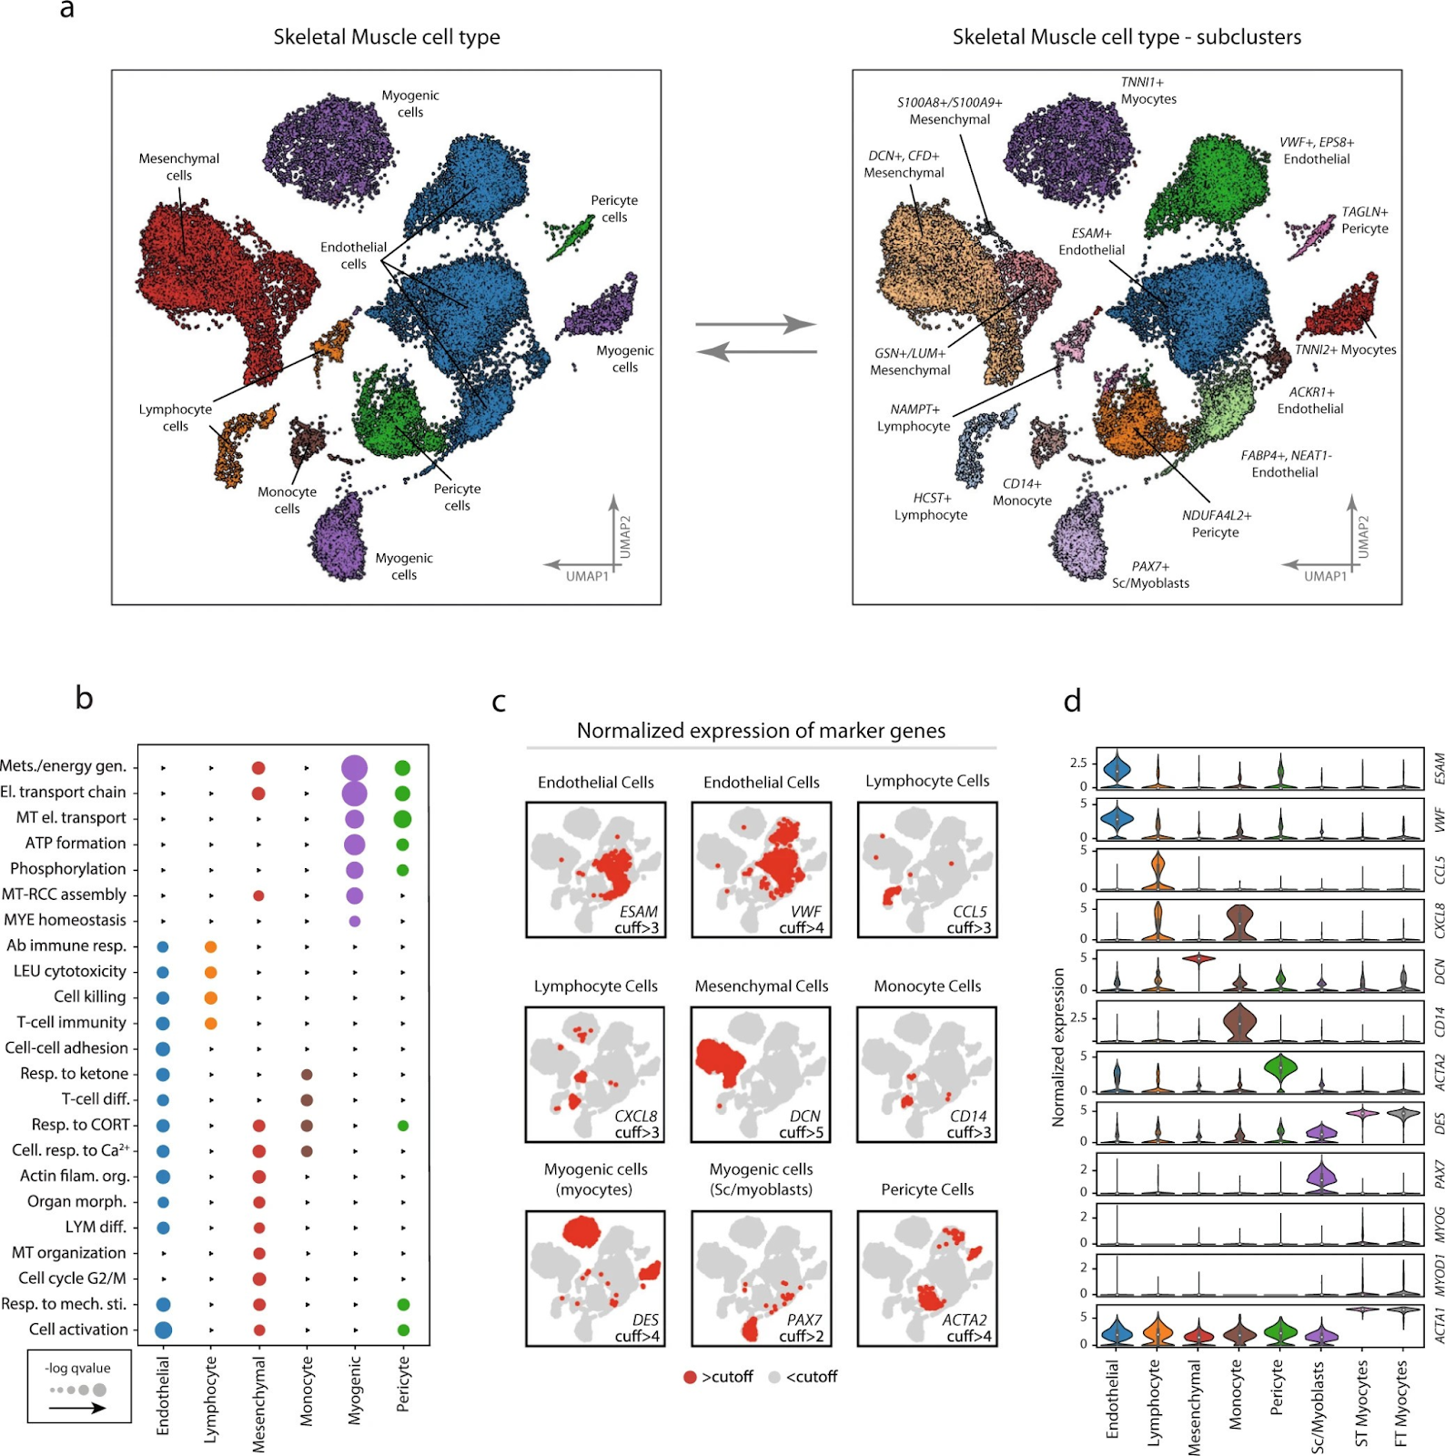
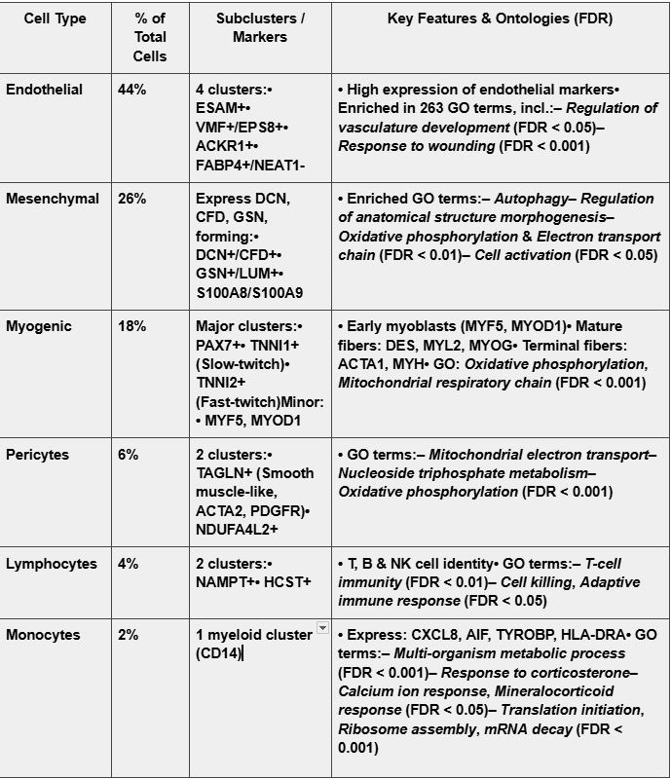
Cellular composition and cell-type characteristics (Fig 2)
8

Slide 9
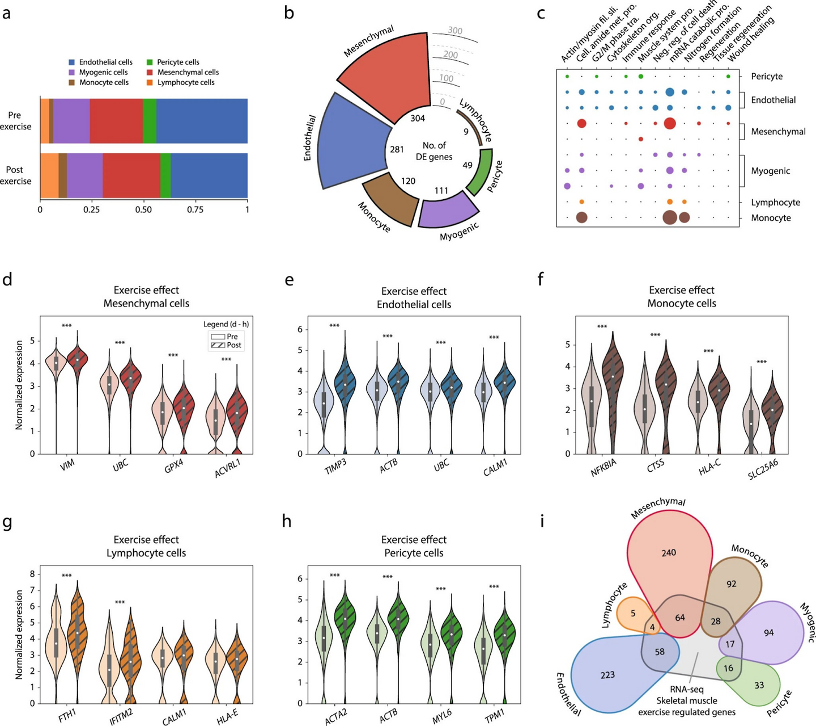
Fig 3: Exercise Effect on Cells
9

Slide 10
1 . Changes in Cell Proportions (Pre vs Post Exercise)
Increased Cell Types:
Lymphocytes (immune cells): 4% → 9%
Monocytes (immune cells): 2% → 4%
Decreased Cell Types:
Endothelial cells (blood vessel cells): 44% → 37%
Pericytes: 6% → 5%
Stable Cell Types:
Myogenic cells (muscle stem/fiber cells): remain ~18%
Key Meaning: Immune cells rapidly move into muscle to support repair and inflammation.
2. Gene Activity – How Strongly Each Cell Type Responds
Mesenchymal cells: 304 (highest response)
Endothelial cells: 281
Monocytes: 120
Myogenic cells: 111
Lymphocytes: 9 (minimal response)
Key Meaning: Some cells (mesenchymal, endothelial) become highly activated, while lymphocytes barely react.
3. Biological Processes Activated After Exercise
Mesenchymal cells: Tissue repair, Wound healing, Extracellular remodeling,
Endothelial cells: Stress response, Metabolic regulation, Vascular adaptation
Myogenic cells: Muscle growth, Fiber contraction, Differentiation (maturation)
Monocytes: Inflammation, Immune signaling
Lymphocytes: Minimal biological change
Common Processes Across Most Cell Types:
mRNA breakdown (catabolic processing)
Nitrogen metabolism
4. Key Genes Highlighted (Panels D–H)
Mesenchymal cells: VIM, GPX4 → structural repair & protection
Endothelial cells: TIMP3, ACTB → vascular stress & remodeling
Myogenic cells: MYOD1, DES → muscle growth & regeneration
Monocytes: NFKBIA, CXCL8 → inflammation & immune response
Key Meaning: Each cell uses specific genes to fulfill its repair or immune role.
5. Comparison to Whole-Muscle RNA-seq (Panel I)
Only ~25% of scRNA-seq genes are detected in bulk RNA-seq.
Reason: Bulk sequencing hides cell-specific responses.
scRNA-seq advantage: Reveals unique reactions of each individual cell type.
Effects of exercise on cellular composition
10

Slide 11
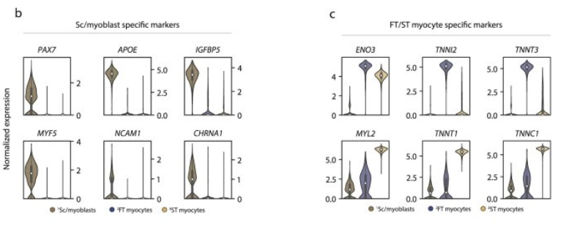
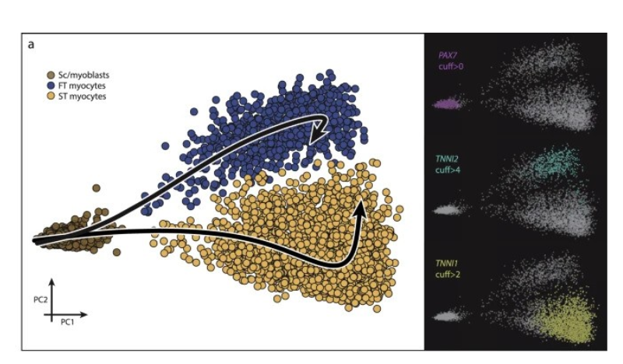
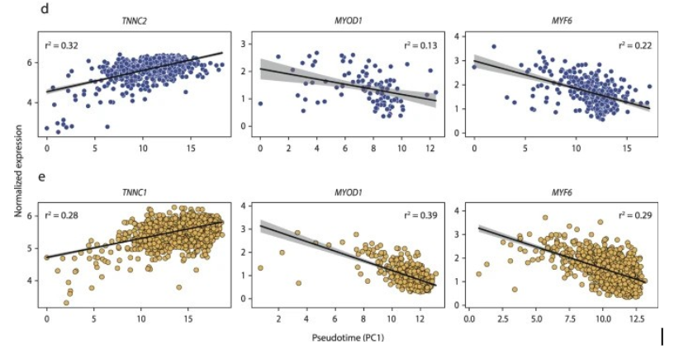
Figure 4 : Trajectory Analysis
11

Slide 12
Figure 4 explanations:
(A) The first cluster (brown) showed high PAX7 expression, marking it as a satellite/myoblast (stem/progenitor) cell group, while the other two clusters represented more mature slow-twitch (TNNI1+) and fast-twitch (TNNI2+) muscle cells along distinct differentiation trajectories.
(B–C) The undifferentiated PAX7+ cells expressed stem/progenitor markers such as PAX7, NCAM1, MYF5, and APOE, whereas the more differentiated cells expressed maturation markers like ENO3, TNNI1, TNNI2, and MYL2.
(D–E) During differentiation, TNNC1 and TNNC2 expression increased progressively along the trajectory, while MYOD1 and MYF5 decreased, indicating a continuous and orderly transition from stem to mature muscle cells.
Overall, the figure illustrates a gradual myogenic differentiation process supported by changes in gene expression patterns consistent with known muscle development pathways.
Trajectory analysis using dimensionality reduction methods such as UMAP or t-SNE revealed a continuous progression of myogenic cell differentiation, rather than distinct separations between cell types. Through principal curve pseudotime analysis, three myogenic subpopulations were identified—undifferentiated PAX7+ myoblasts, TNNI1+ slow-twitch, and TNNI2+ fast-twitch cells—arranged along two differentiation trajectories originating from the myoblast cluster. As pseudotime increased, TNNC1 and TNNC2 expression rose progressively in both muscle types, reflecting ongoing maturation. Notably, after three hours of exercise, both slow- and fast-twitch populations showed a slight shift toward higher differentiation, indicating that exercise acutely promotes myogenic progression.
12

Slide 13
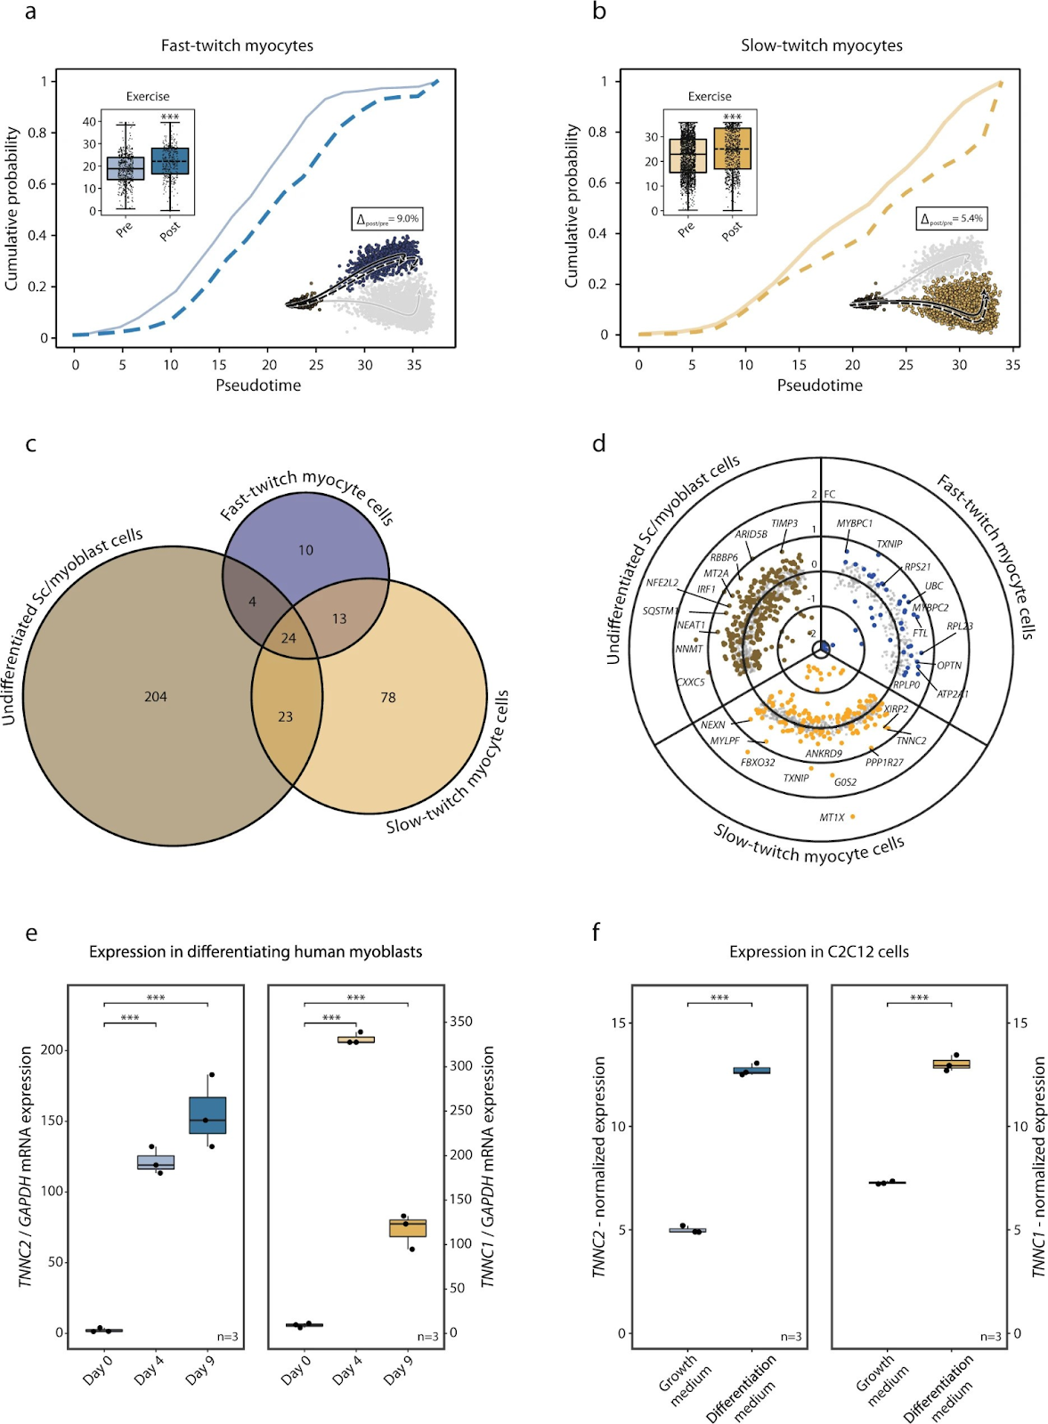
Fig 5: Pseudotime Analysis
This figure shows how exercise affects muscle-forming (myogenic) cells and their gene activity.
(a–b) After 3 hours of exercise, both fast-twitch and slow-twitch muscle cells showed a clear shift (9% and 5.4%) along their differentiation paths, meaning they became slightly more mature.
(c) A Venn diagram showed that most exercise-responsive genes appeared in undifferentiated PAX7+ stem/myoblast cells, and many of those same genes were also affected in the more mature muscle cells — suggesting exercise mainly influences early-stage muscle cells.
(d) A volcano plot displayed which genes changed significantly after exercise in each myogenic group (with different colors for each type).
(e) Lab tests using human myoblasts grown in culture confirmed that troponin genes (TNNC1 and TNNC2) increase as the cells mature over several days, matching the single-cell results.
(f) A similar result was seen in C2C12 mouse muscle cells, where gene activity changed as they shifted from growth to differentiation.
Overall: Exercise triggers early gene changes that promote muscle cell differentiation and maturation, especially in the stem-like PAX7+ cells.
13

Slide 14
Discussion
This study used single-cell RNA sequencing (scRNA-seq) to closely examine the different types of cells in adult human skeletal muscle and how they react to exercise. The method was reliable between samples and people, showing consistent results.
Researchers found that muscle tissue contains several main cell types: endothelial cells (44%), mesenchymal cells (26%), myogenic or muscle-forming cells (18%), and smaller groups of pericytes and immune cells. The proportions matched earlier studies, showing that scRNA-seq gives an accurate picture of muscle composition.
After intense sprint exercise, most cell types stayed about the same in number, except for a small increase in lymphocytes (immune cells) — likely due to higher blood flow, not immune activation. However, gene activity changed a lot in specific cell types, especially mesenchymal, endothelial, and myogenic cells, which showed signs of tissue repair, remodeling, and blood vessel growth.
Among the myogenic (muscle-forming) cells, three subgroups were identified:
Undifferentiated PAX7+ stem/myoblast cells,
TNNI1+ slow-twitch, and
TNNI2+ fast-twitch cells.
These groups formed a continuous differentiation pathway, meaning muscle cells gradually mature rather than changing in sudden steps. After a single exercise session, there was a noticeable shift toward more mature muscle gene activity, especially in slow-twitch cells, suggesting early signs of adaptation.
Lab experiments using human and mouse muscle cells (C2C12) confirmed that troponin genes (TNNI1, TNNI2) increase as muscle cells mature, while early-stage genes like MYOD1 and MYF5 decrease.
Overall, the study shows that:
scRNA-seq can accurately identify and track cell populations in muscle.
Exercise triggers cell-type-specific gene responses, mainly in mesenchymal, endothelial, and myogenic cells.
Muscle stem cells begin to differentiate toward mature slow- or fast-twitch fibers soon after exercise, possibly contributing to longer-term muscle adaptation.
The authors note that the study had few subjects, so broader patterns (like differences by age or sex) need more research. Still, the findings highlight how a single exercise session can activate muscle regeneration and remodeling at the cellular level.
14

Slide 15
1. Small Sample Size
The study included very few human participants (young, healthy males only).
Because of this, the findings may not apply to older adults, females, people with diseases, or different training backgrounds.
2. Single Time Point After Exercise
Samples were taken only once, 3 hours after exercise.
This misses earlier and later responses (e.g., 30 min, 24 h, 48 h).
Muscle remodeling is a long process, so one time point cannot capture the full timeline.
3. Single Acute Exercise Session
They measured the effect of one exercise session, not long-term training.
Chronic training may create different or stronger cellular responses.
4. Biopsy Sampling Limitations
Muscle biopsies only represent a tiny part of the muscle.
The sampling area may not fully represent the whole muscle tissue.
Biopsies taken before and after exercise might be from slightly different regions, creating variability.
5. Single-cell RNA Sequencing Limitations
a. Dropout Effects
scRNA-seq often misses low-expressed genes, leading to incomplete gene expression profiles.
b. Cell Stress From Tissue Dissociation
Breaking tissue into single cells can stress or alter the cells, changing their gene expression artificially.
c. Different Cells Survive Dissociation Unequally
Some fragile cell types may die during preparation, so they are underrepresented in the final dataset.
d. Pseudotime Analysis Is Not Real Time
Pseudotime describes a modelled trajectory, not actual timing.
It cannot perfectly reconstruct the real developmental or differentiation timeline.
6. Limited Ability to Track Individual Myogenic Cells
The study is cross-sectional, not longitudinal.
They did not track the same cell before and after exercise.
Thus, we cannot be certain how each individual cell changes over time.
7. Bulk Validation vs. Single-cell Data
Validation experiments (RT-PCR, C2C12 cells) use bulk cell populations, not single cells.
This means validation confirms general trends but cannot confirm specific single-cell patterns.
8. Species and In Vitro Limitations
C2C12 cells are mouse cells grown in a dish.
Their differentiation behaviour may not perfectly match human muscle biology.
9. Study Focused on Vastus Lateralis Only
They only sampled one muscle (quadriceps vastus lateralis).
Other muscles (e.g., calf, arm, respiratory muscles) may respond differently.
10. Limited Insight Into Protein-Level Changes
The study mainly looks at RNA, not proteins.
RNA changes do not always translate into protein or functional changes.
Without proteomics, the functional significance remains partly unknown.
Limitations
15

Slide 16
Thank You!
Any Questions?
16

